Slide 1



Why re-use core classes? A plea to developers of Bioconductor packages
Levi Waldron
Oct 16, 2017
Notes:
Hi, I’m Levi Waldron, and I’m here to try and convince you, as Bioconductor package developer, to take extra care in figuring out how to make existing core classes work for you.

Slide 2
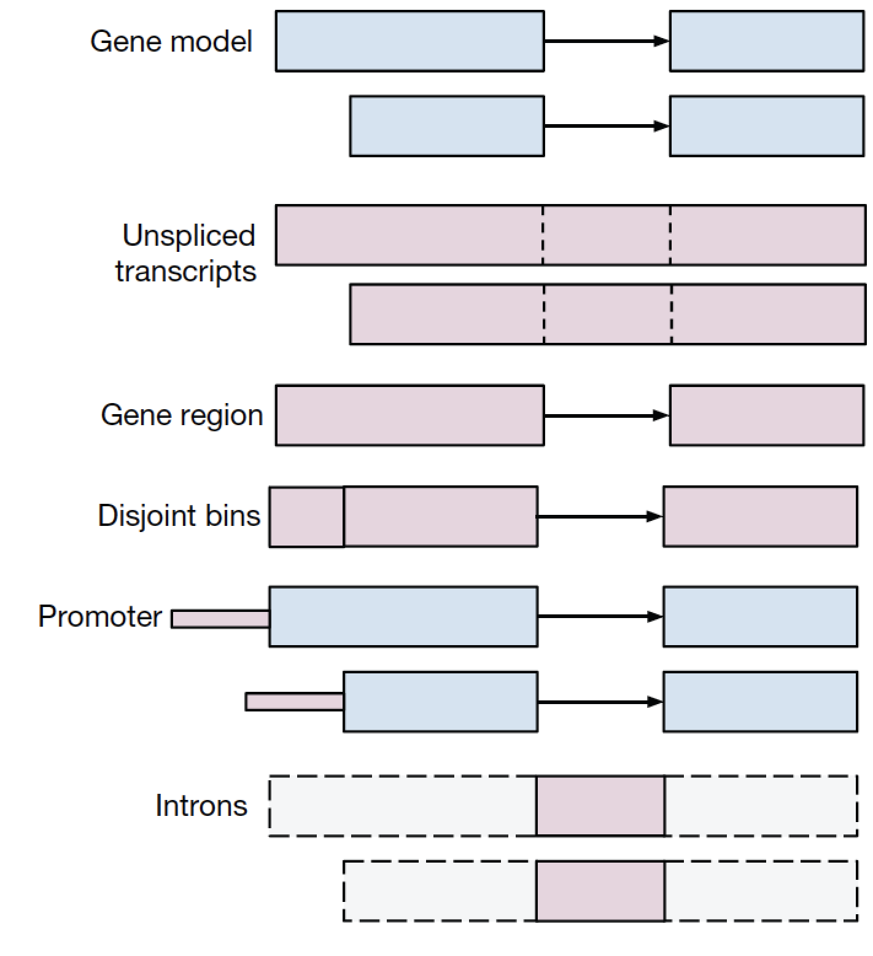
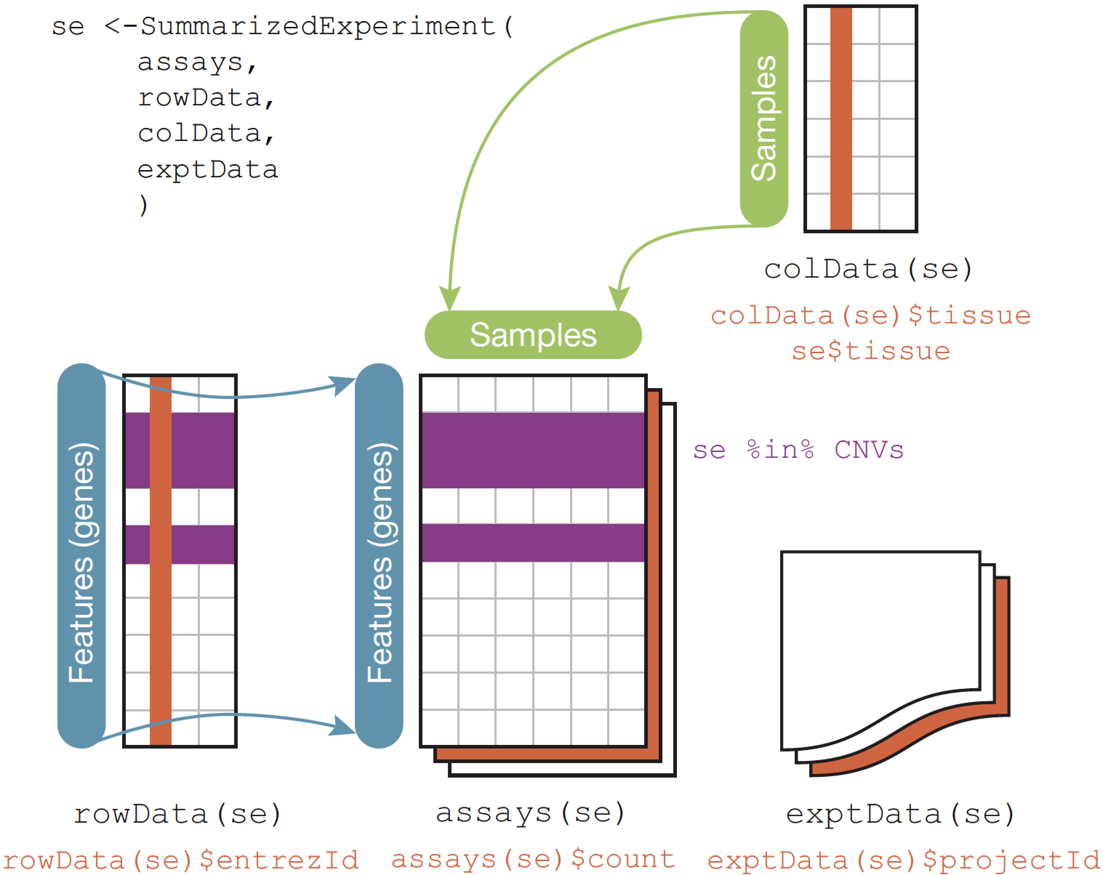
What is Bioconductor?
1,400 packages on a backbone of data structures
The Genomic Ranges algebra
The integrative data container SummarizedExperiment
Huber, W. et al. Orchestrating high-throughput genomic analysis with Bioconductor. Nat. Methods 12, 115–121 (2015).
Notes:
For most users, Bioconductor is a set of packages, more than 1,400 of them now, providing an enormous range of statistical analyses and visualization for high-throughput biological data, accessible via the R programming language. But just as important is a backbone of core data structures designed for the requirements of specific genomic data types.
For example, the Genomic Ranges system provides a representation and algebra for any data associated with genomic coordinates. Efficient in-memory and on-disk representations
Integrative data containers such as SummarizedExperiment, integrate high-throughput data with, for example, gene annotations, sample data such as clinical information, experimental metadata, and can even represent multiple assays. In this case, however, the assays must be matrix-like and of identical dimensions

Slide 3
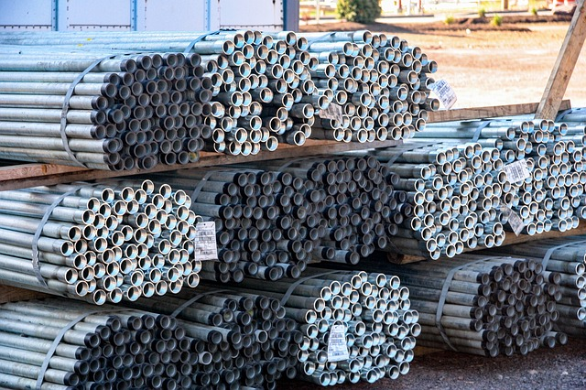
Why do core classes matter to developers?
Let’s say you have a great idea for an improved bicycle
raw steel
forge frame
New rocket-powered bike
What could possibly go wrong?
Notes:
I'm going to make the case that, as a Bioconductor package developer, you should almost always rely on what I'll call "core" Bioconductor data classes from the early stages of development. Why should these core classes matter to you? Well, let's say you have a great idea for an improved bicycle. Better than existing bicycles. But you want to build it from scratch, so you start from raw steel. You forge your frame in a furnace, then add your components that contain what is really your improvement, and you successfully create your new rocket-powered bike. It's clearly an improvement over non rocket-powered bikes, and you convince the reviewers of this and publish your paper. So what could possibly go wrong once you release your new invention and lots of people start using it?

Slide 4
Why do core classes matter to developers?
What could possibly go wrong?
Your frame has limited testing
Your frame lacks features you never even thought of
Ouch!
Little eyelets allows users to install a rack and fenders
Notes:
Well for one thing, if your expertise is on rocket-building and not on frame-building, your frame might have some flaws, that only show up later after much use and testing. Second, your frame might lack features that

Slide 5
Why do core classes matter to developers?
It’s easy to define a new S4 class in R
> setClass("BicycleFrame",
representation(height = "numeric", color = "character"))
> my.new.frame <- new("BicycleFrame", height = 31, color = "red")
> my.new.frame
An object of class "BicycleFrame"
Slot "height":
[1] 31
Slot "color":
[1] "red”
>
However, it’s very difficult to define a
robust and flexible data class for genomic data analysis

Slide 6
Why do core classes matter to developers?
From phyloseq Bioconductor package
setClass(Class="phyloseq",
representation=representation(
otu_table="otu_tableOrNULL",
tax_table="taxonomyTableOrNULL",
sam_data="sample_dataOrNULL",
phy_tree="phyloOrNULL",
refseq = "XStringSetOrNULL")
)
Does not contain any base class
It is a list with elements of defined class
Notes:
I'm going to give a couple examples from real packages in Bioconductor. I'm not doing this to criticize or compliment anyone, only to show some real-life consequences of these design decisions. The phyloseq package for the analysis of microbiome data is a very well-used and useful package, and one I use myself frequently. It's basic data class is called phyloseq, and this is its definition. This class contains several slots to contain data from microbiome experiments, the taxonomy of those microbes, data about the where each of those microbiome profiles were taken from, and phylogenetic relationships between the microbes. It is defined from “scratch” – it does not contain any base class, therefore the developers had to develop all the methods associated with this class.

Slide 7
Why do core classes matter to developers?
From the metagenomeSeq Bioconductor package
setClass("MRexperiment", contains=c("eSet"),
representation=representation(
expSummary = "environment"))
)
Contains the eSet base virtual class
(since outdated by SummarizedExperiment)
Notes:
Another package for microbiome data analysis, metagenomeSeq, instead defines a class derived from the eSet virtual class, which can be considered a base Bioconductor class although it is now outdated by the SummarizedExperiment class. The MRexperiment class only adds a single slot to this base class, expSummary.

Slide 8
Live demo

Slide 9
What are the “core” classes?
Rectangular feature x sample data (RNAseq count matrix, microarray, …)
SummarizedExperiment::SummarizedExperiment()
Genomic coordinates (1-based, closed interval)
GenomicRanges::GRanges()
DNA / RNA / AA sequences
Biostrings::*Stringset()
Gene sets
GSEABase::GeneSet()
GSEABase::GeneSetCollection()
Multi-omics data
MultiAssayExperiment::MultiAssayExperiment()
Single cell data
SingleCellExperiment::SingleCellExperiment()
Mass spectrometry data
MSnbase::MSnExp()
https://www.bioconductor.org/developers/how-to/commonMethodsAndClasses/

Slide 10
Core classes represent years of work and maintenance by experienced developers
Bioconductor core team members
Martin Morgan (Project Lead)
Hervé Pagès
James MacDonald
Valerie Obenchain
Andrzej Oleś
Marcel Ramos
Lori Shepherd
Nitesh Turaga
Daniel van Twisk
So you can spend less time frame-building
And more time building rocket boosters

